Slide 1
AI 데이터 라벨링 서비스
영어 번역본

Slide 2
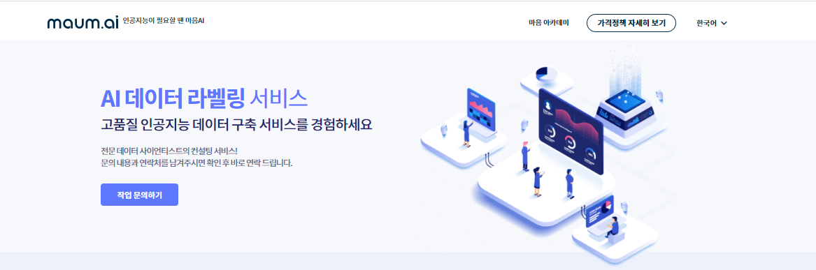
Make your own AI Service
maum Academy
Pricing
AI Data Labeling Services
Experience the highest quality labeled data
Easy to use and easily customizable tool with professional service offered by data scientists.
Contact Us

Slide 3
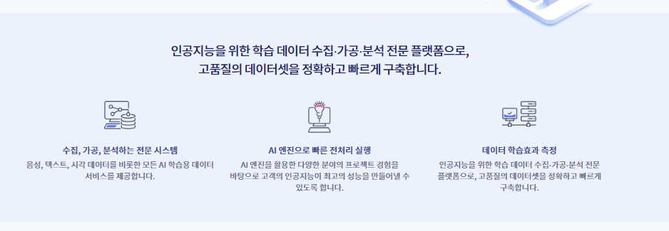
Data Annotation Tools and Services from Collection to Analysis
Collect, annotate, and analyze
From collection to analysis, we process the basics of AI training data: voice, image, video, text.
Efficient and effective process
By taking advantage of our expertise in AI platform and machine learning-based projects, we minimize time and resources on data processing.
Best Quality Data for AI projects
We analyze and select the data before the annotation to make the AI engine's best performance.

Slide 4
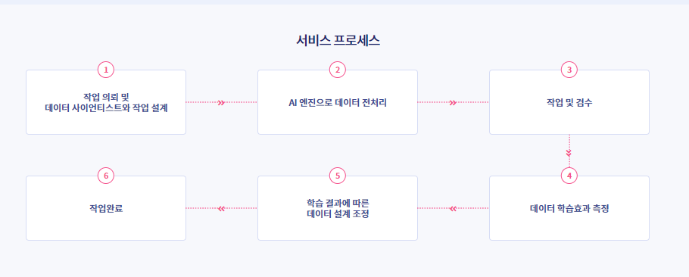
Data Annotation Services
Consultation and data design with data scientists
Preprocessing of data by using AI engines
Labeling and QA
Project completed
Data design modification
(if needed)
Interim review with the customer

Slide 5
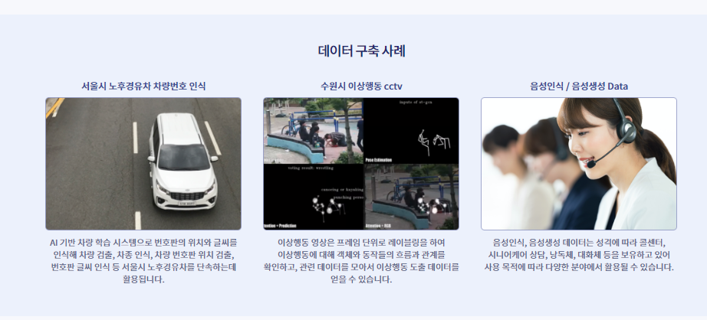
Use Cases
Detecting License Plate Number of Old Cars, Seoul Metropolitan Government
Anomaly Detection from Surveillance Camera, Suwon Metropolitan City
Data for Speech Recognition & Generation
The AI-based vehicle detection on types and numbers of vehicles. Labeled data of license plate and the location of the plate are used.
Detects twelve types of abnormal events by labeling subjects and the motions and connecting the relationship between the two.
Written data to create various types of speech patterns and audio files for accurate transcription of speech data.

Slide 6
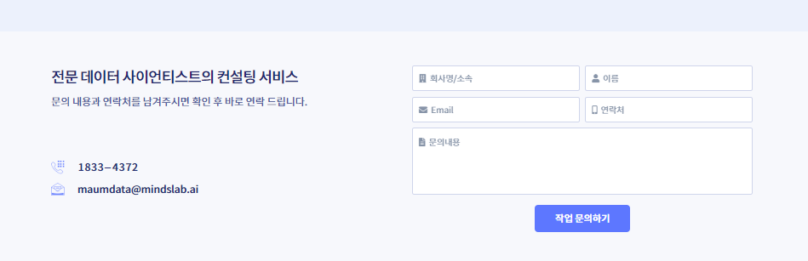
Company/ Department
Name
Consult with our Data Science Team
Please leave your contact information and inquiries.
Phone Number
Inquiries
Submit

